Slide 1
The added costs of those other things.

Slide 2
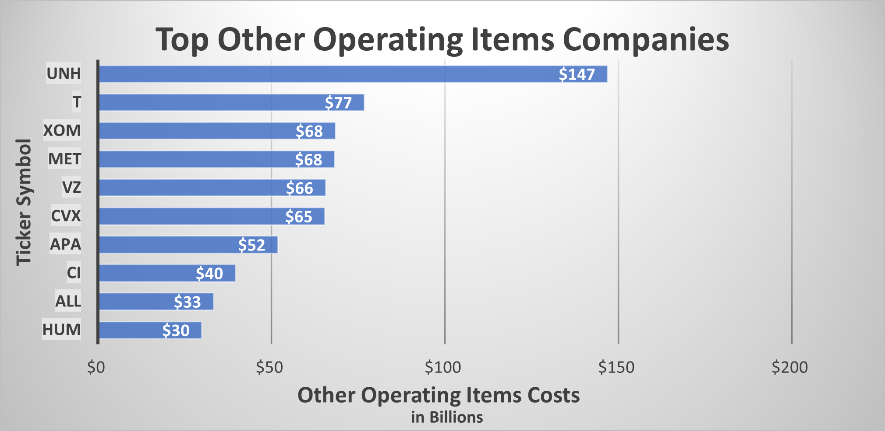
Does having a high other operating items cost equate to a high total revenue?
According to Forbes.com, United Healthcare’s (UNH) other operating costs is so high is due to the vast amount of people that they have to provide care to. As the world’s largest health insurance, I will demonstrate their steady return from 2013 to 2016. Here we see that UNH is the number 1 of 10 companies with the highest other operating costs company. Do you think they are the highest Total revenue of the the same group?
<visualization or summary statistics used for finding>

Slide 3
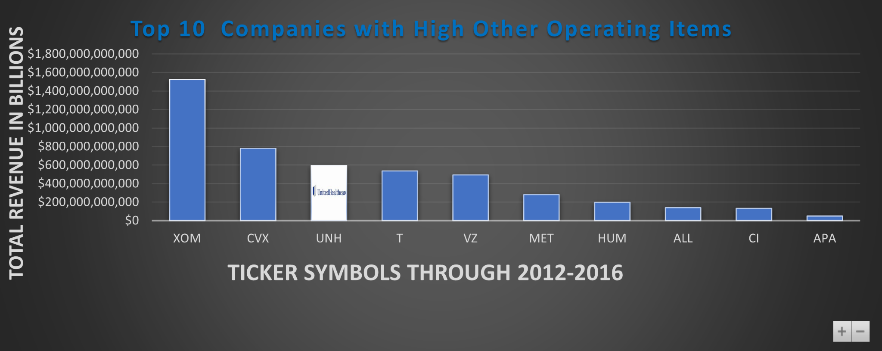
Surprised?!
UHN has 3rd largest Total Revenue of the same group. Continued from what I read on Forbes.com,
I used the bar charts to correlate category principles with each one. Bar graphs are easy to understand especially when dealing with money and dates.

Slide 4
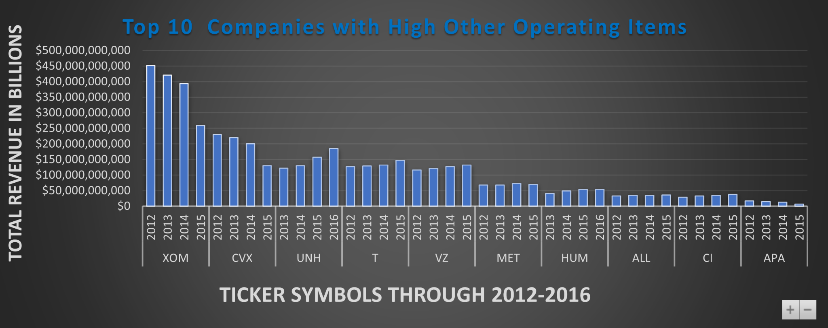
United Healthcare is steady growing…..
Notice the right skewed distribution as we drill down to breakdown the for each year.While the first and the second are left skewed. I think the other operating Items could very well help keep them growing.

